Slide 1
Serving the underserved Joel Gaertner WELS Special Ministries

Slide 2
“The King will reply, ‘Truly I tell you, whatever you did for one of the least of these brothers and sisters of mine, you did for me.’” (Matthew 25:40)

Slide 3
Who are “the least of these”?

Slide 4
The Poor Children Elderly Addicts Those who are abused Those with special needs & other disabilities

Slide 5
8 million

Slide 6
8 million 80 % of the 10 million individuals with special needs in the US

Slide 7
8 million 80 % of the 10 million individuals with special needs in the US do not feel welcomed in church

Slide 8
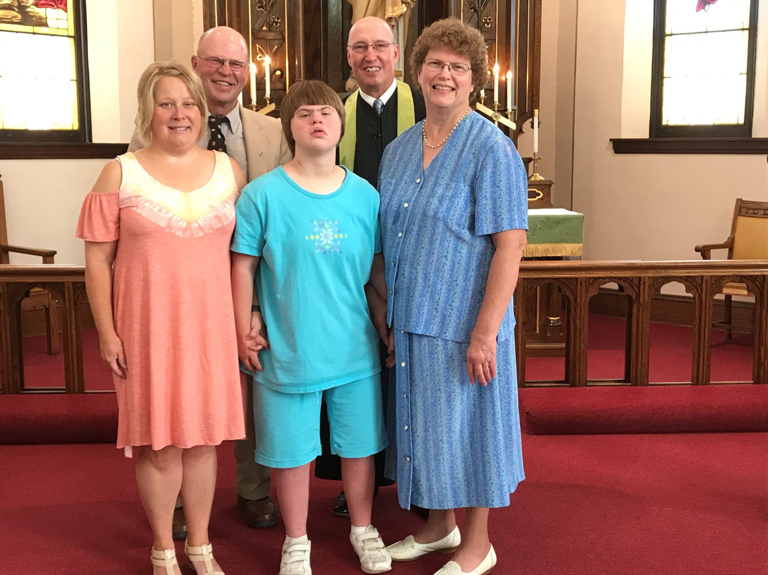
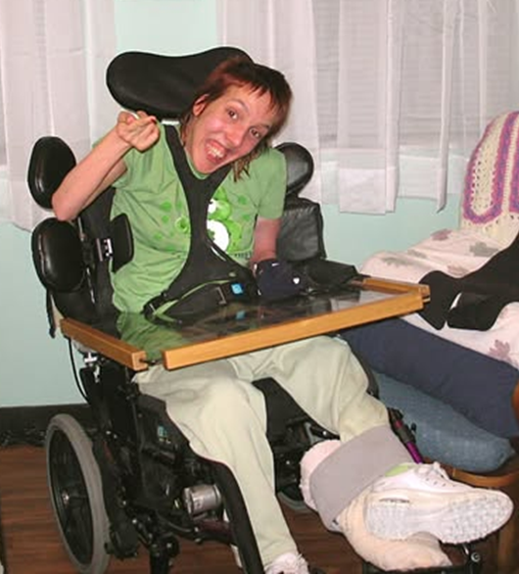
How and what I learned from Debbie

Slide 9
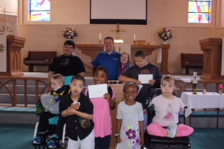
Baptism

Slide 10

Confirmation

Slide 11
1 in 10 people in the US is deaf or hard of hearing As people age, that increases to 1 in 3

Slide 12
Approximately 7 million people in the United States have vision impairment. This includes 1 million with blindness. That is 2-3% of the regular population 6% of people 65 and older

Slide 13
WELS Special Ministries https://wels.net/serving-you/christian-life/special-ministries/ Joel Gaertner joel.gaertner@wels.net 920-517-0381

